Slide 1



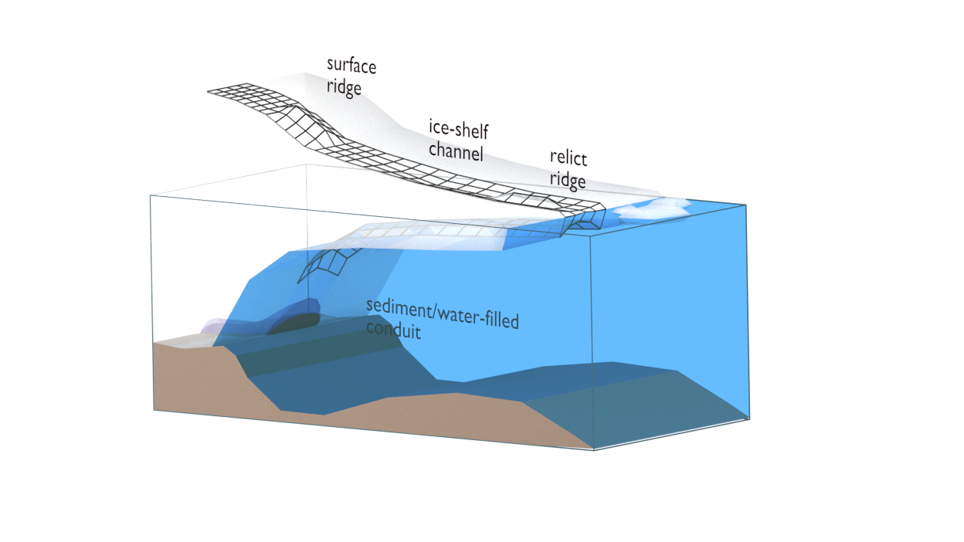
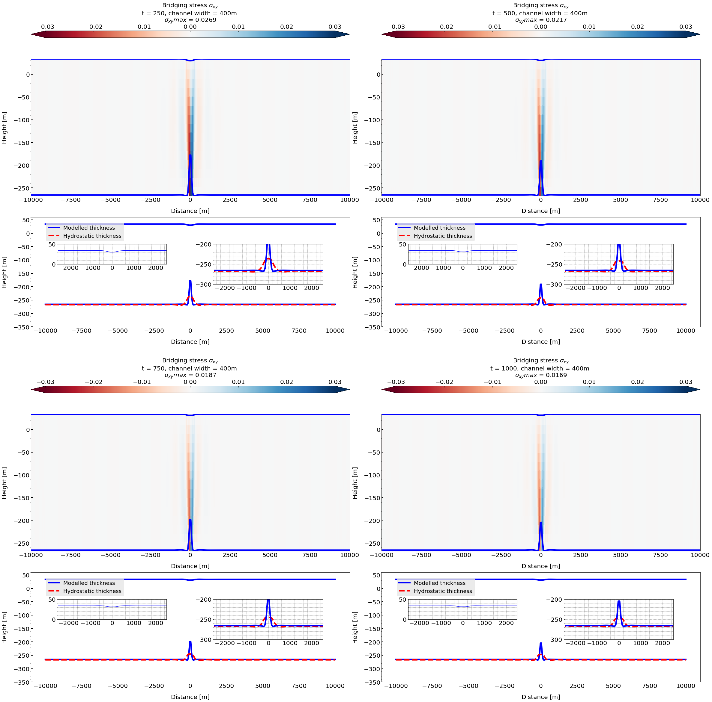
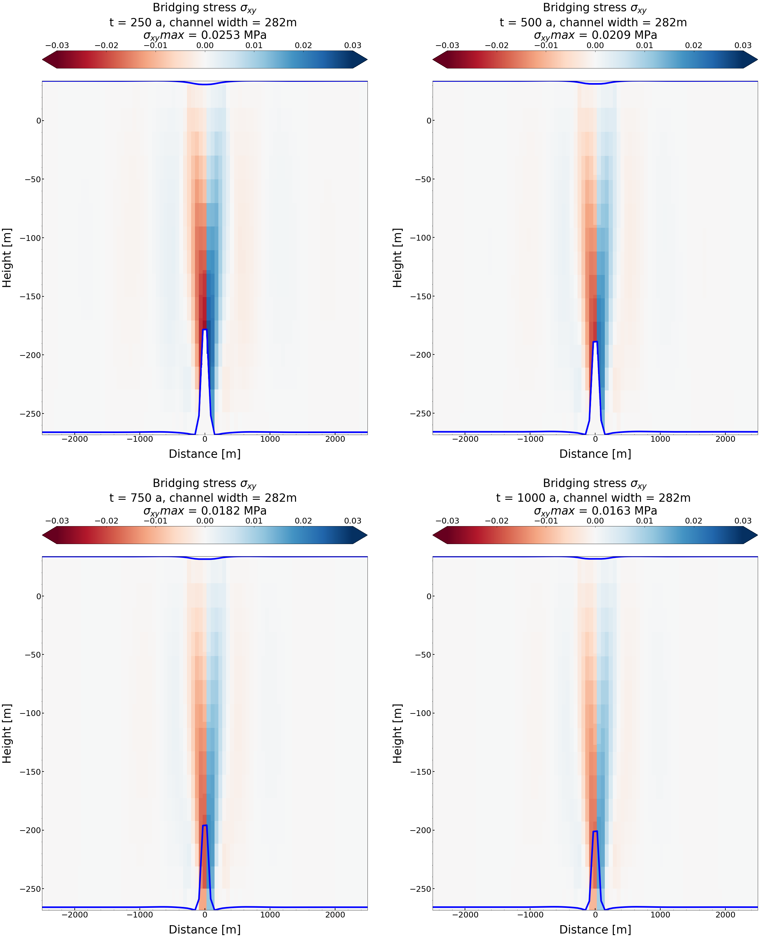
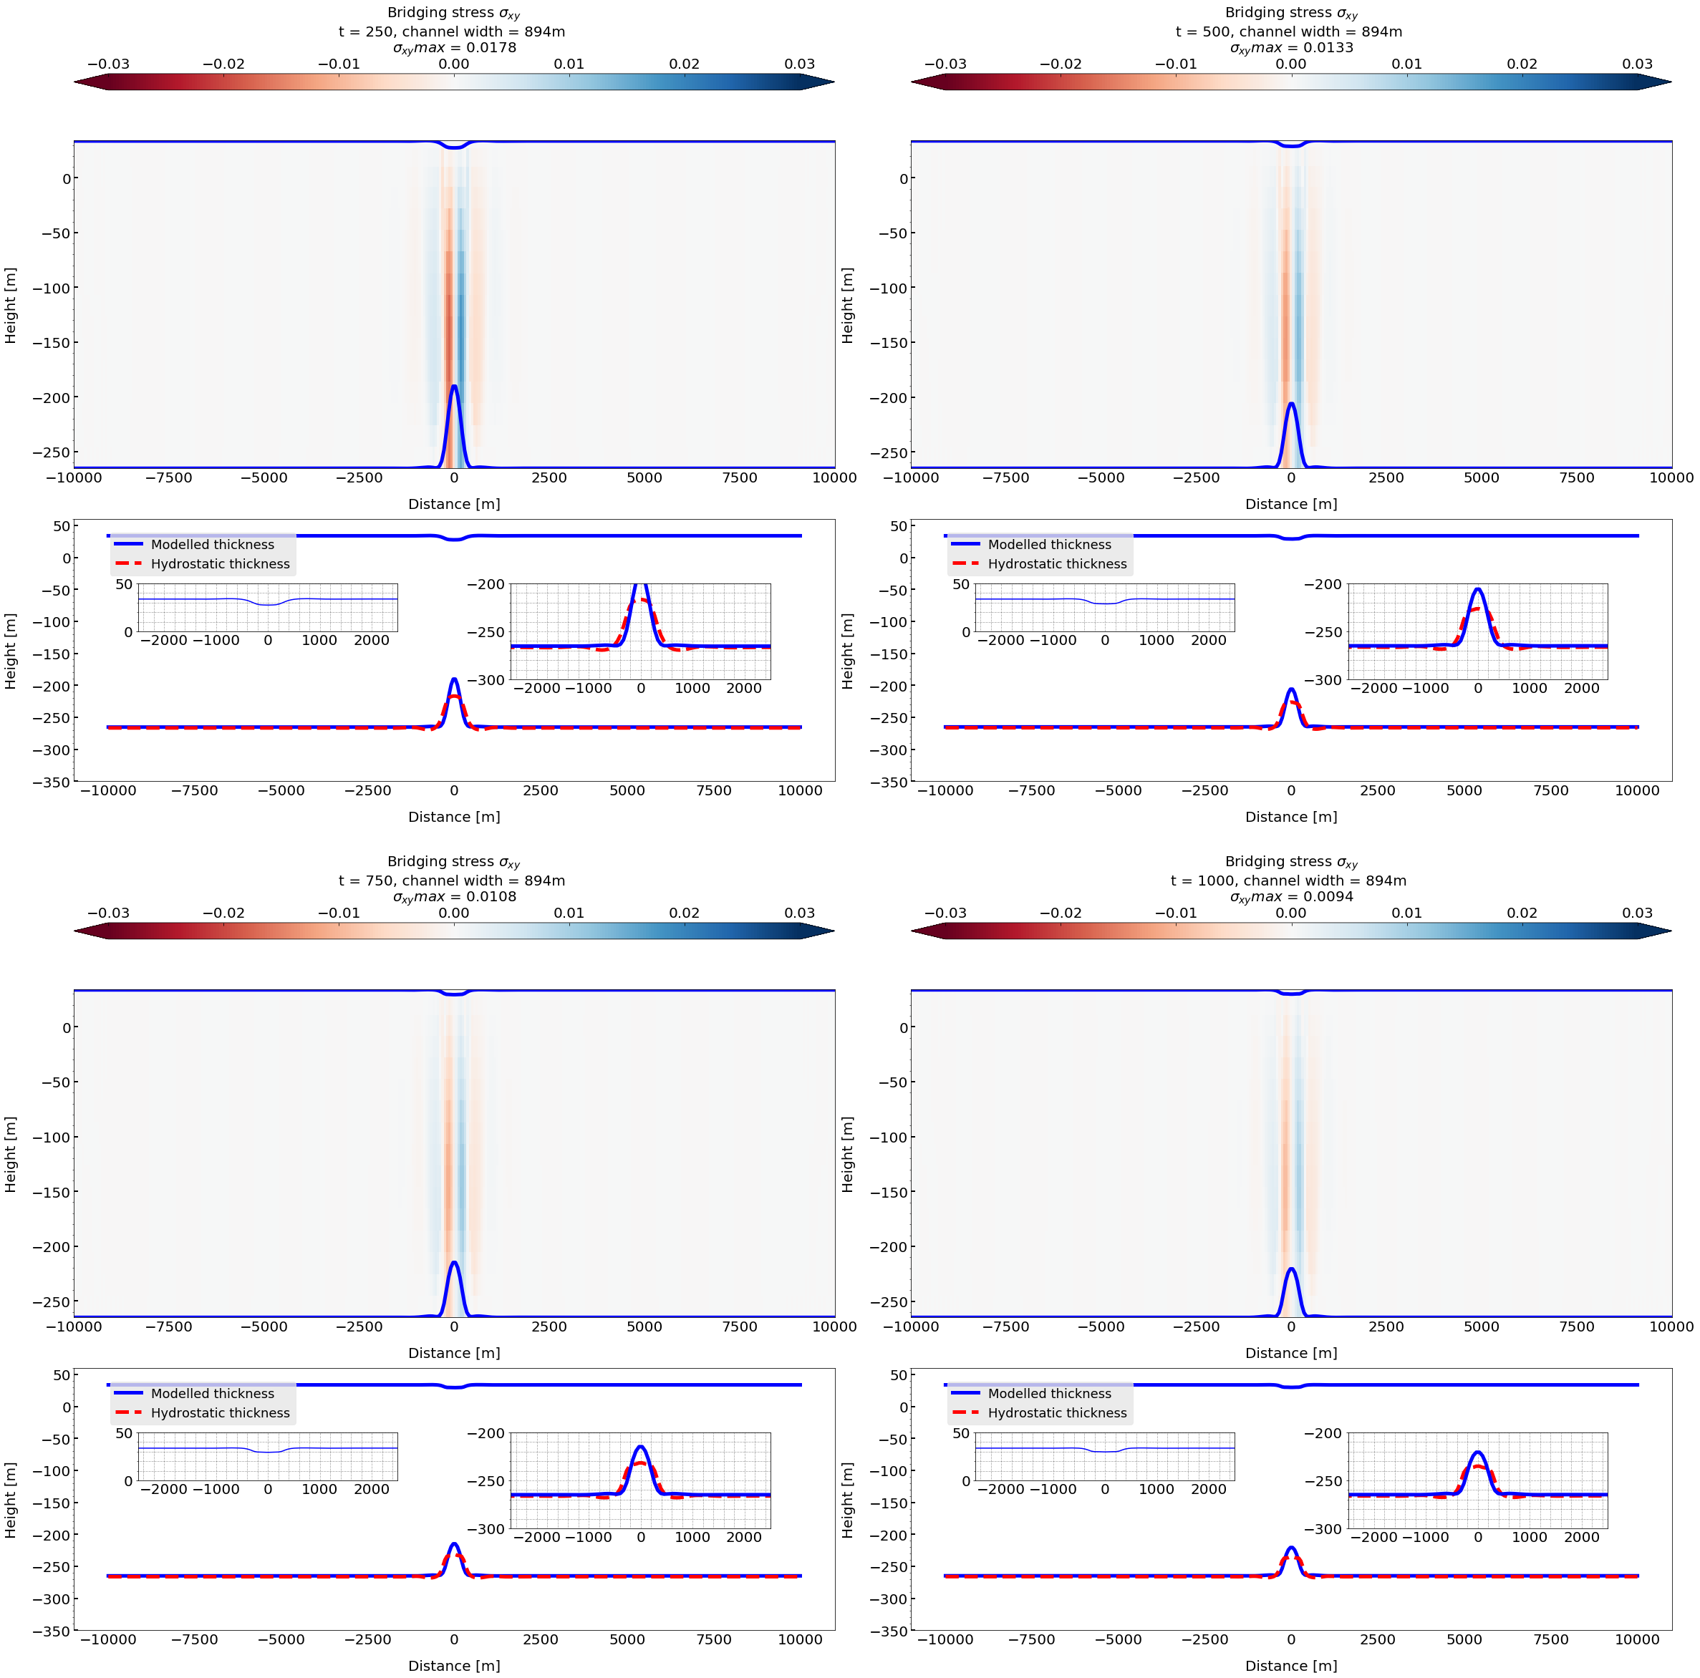
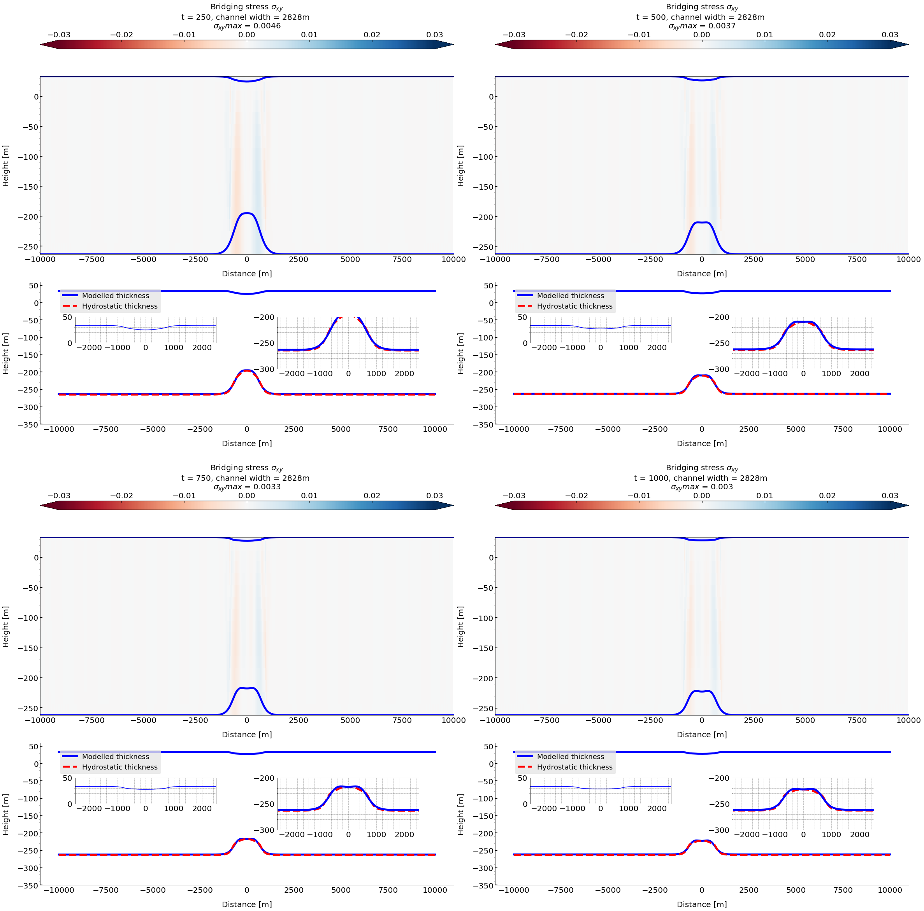
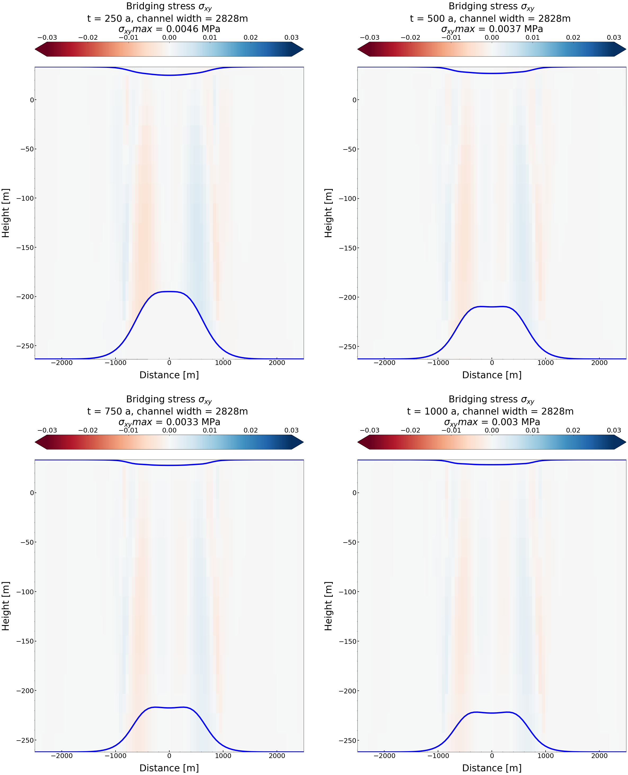
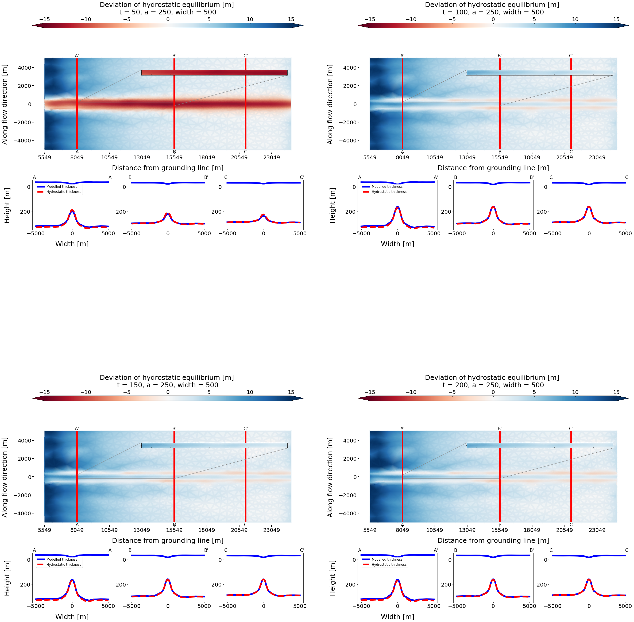
Modelling the impact of ice shelf-channels on ice sheet/ shelf instability
Julius Loos
Supervisors: Jnr. Prof. Reinhard Drews, PhD Clemens Schannwell, Prof. Todd Ehlers
Earth System Dynamics Group, Department of Geosciences, Eberhard Karls University Tübingen
Introduction
Scientific Question
Ice shelves are the floating tongue extensions of grounded glaciers (ice-sheets) in Antarctica and Greenland. The buttressing effect (back stress) of ice-shelves in Antarctica is the key driver on the stability of vulnerable regions in the Antarctic ^{[1]}. The transition zone/line between ice-sheet and ice-shelf (grounding line) controls the continental mass flux and regulates the disintegration of the ice-shelf. Eventually, this process leads to acceleration of continental ice flux, hence to a contribution to the global sea-level budget ^{[2]}. Ice-shelf channels (longitudinal depressions at top and bottom of the ice-shelf) are known to alter stress distribution in the interior of the ice-shelf and eventually weaken its integrity due to fractures and rifts ^{[3][4]}. In this thesis, the influence of altering widths of ice-shelf channels on bridging (variation in shear-stress) and hydrostatic deviation in a purely synthetic 2D a 3D Full-Stokes model (using ELMER/ICE) is analysed.
How is the altering width of ice-shelf channels correlated to stresses in the ice-shelf and imbalances of hydrostatic thickness?
Conclusion & Outlook
Narrow channels (approx. < 1500 m) are not in hydrostatic equilibrium and show higher bridging stresses in an idealized ice-shelf setup
Wider channels (approx. > 1500 m) can be in steady state, hence in hydrostatic equilibirum (bridging can be neglected)
Hydrostatic deviation is a linear decreasing function with increasing channel widths
Further work of thesis: Extension of ice-shelf domain and its influence on hydrostatic equilibrium and ice-shelf channel formation
Channelized melting could be induced through bedrock-bump in a FS- coupled ice-sheet / shelf model setup
2D
Figure 1 (left). 3D scheme of ice-sheet/ shelf with ice-shelf channel formation after Drews et al. (2017). Transition zone of ice-sheet and shelf at red, solid line: grounding line (GL). Bedrock- bump initializes ice-shelf channel on top of the ice-surface due to melting. This scheme’s geometry of ice-sheet/ shelf can be applied to the 3D simulation case.
3D
GL
Results
a.1)
a.2)
a.3)
a.1)
a.2)
t = 250 a
t = 500 a
b.1)
b.2)
b.3)
t = 250 a
t = 500 a
c.1)
c.2)
c.3)
b.1)
b.2)
t = 250 a
t = 500 a
Figure 2. Rows: channel widths (400 m, 894 m and 2828 m). Left section (a.1, b.1, c.1) shows the modelled hydrostatic thickness with top and bottom of ice-shelf (blue curve) versus the calculated hydrostatic thickness (dotted red curve) after 250 years, right section (a.3,b.3,c.3) after 500 years. X-axis is the total shelf width, y-axis the vertical extent. The initial channel amplitude (without melting) remains for altering widths at 150 m. Middle section depicts the root-mean square of the hydrostatic deviation between modelled and calculated thickness over the whole ice-shelf domain (x = 10 km). As a reference, the RMS of a channel with width = 282 m is plotted along with the channels with increasing width. 2D simulation case.
Figure 4 (left). Summary of the RMS of the hydrostatic deviation as a function of alternating channel widths in a 2D simulation case (> 20 runs). Five timesteps are plotted. Lines show a linear decreasing function of hydrostatic deviation with increasing channel width size (red dotted box).
Figure 5 (right). 3D simulation case of coupled ice sheet/shelf. Channel is initialized through a bump at the bedrock of ice sheet (gauss function with 250 m amplitude, 1000 m total width). a) shows hydrostatic deviation after 200 a, starting from approx. 5000 m distance from GL (cropped). b), c), d) show top and bottom of ice-shelf at given cross-sections with modelled thickness (blue, solid) and the calculated hydrostatic thickness (red, dotted).
a)
Figure 3. First row: channel width 282 m after 250 a and 500 a (a.1, a.2). Second row: channel width 2828 m after 250 a and 500 a (b.1, b.2). Blue, solid lines show top and bottom of ice-shelf (channel). Bridging occurs, where the overburden column of ice is not supported from below. A.1 and a.2 show higher bridging effects than b.1 and b.2 (wider channels). 2D simulation case.
b)
c)
d)
Methods
The ice shelf/ sheet model domain is idealized: Ice dynamics are better emphazised,neglecting disturbing features of DEM. 2D: channel initialized with melting function
3D: channel initialized as a function of bedrock topography (bedrock bump).
Synthetic
Geometry
Model domain is seperated in multiple partitions and then runs on multiple cores:
HPC - Cluster
Large simulation files, which store scalar and vector data for each partition (declared by .sif). The original file format is XML.
The ModelRun.py class rearranges and analyses the output of large parallel .vtu files in 2D and 3D, especially for multiple runs (numpy format). It includes several functions to compute hydrostatic deviation, concave hull or RMS in 2D and 3D (for given crosssection of the ice-shelf).
Input
2D shelf & 3D shelf/sheet
model setup
Initialize transient model with synthetic geometry
partitioning
HPC
runs in parallel
Output
contains
Filetype for reader:
.pvtu
Input
Python Class:
ModelRun.py
The .sif contains information about material properties, variables, boundary conditions as well as user solver functions.
Elmer/Ice
Filetype:
.sif
Input
Partitioning:
20 partitions in 3D,
4 partitions in 2D
Finite Element Method solves Stokes EQ. in 2D (Full-Stokes in 3D)
Visualisation:
ParaView
User functions for ModelRun - class
References
[1] Gudmundsson, H. (2013). Ice-shelf buttressing and the stability of marine ice sheets. The Cryosphere, 7(2), 647-655.
[2] Scambos, T. A., Bohlander, J. A., Shuman, C. U., & Skvarca, P. (2004). Glacier acceleration and thinning after ice shelf collapse in the Larsen B embayment, Antarctica. Geophysical Research Letters, 31(18).
[3] Borstad, C. P., Rignot, E., Mouginot, J., & Schodlok, M. P. (2013). Creep deformation and buttressing capacity of damaged ice shelves: theory and application to Larsen C ice shelf.
[4] Drews, R. (2015). Evolution of ice-shelf channels in Antarctic ice shelves. The Cryosphere, 9(3), 1169-1181.
[5] Drews, R., Pattyn, F., Hewitt, I. J., Ng, F. S. L., Berger, S., Matsuoka, K., ... & Neckel, N. (2017). Actively evolving subglacial conduits and eskers initiate ice shelf channels at an Antarctic grounding line. Nature communications, 8, 15228.

